Slide 1

Introductory Statistics/ Refresher & Intro to Labs
Thilanka Munasinghe
Data Analytics
ITWS-4600/ITWS-6600/MATP-4450/CSCI-4960
Group 1, Week1 - Module 2, January 28th, 2021

Slide 2
Your Github Repository
Your Github Repository for this class
Please create a Github repo for the Data Analytics class Labs
Do not share the Assignment codes in your Data Analytics course repo, you share only your lab work and your individual project work/code.
TA will collect your Github repo URLs next week.
Example: https://github.com/tYourGithub/DataAnalytics2021_YOUR_NAME

Slide 3
Definitions/ topics
Statistic
Statistics
Population and Samples
Sampling
Distributions and parameters
Central Tendencies
Frequency
Probability
Significance tests
Hypothesis (null and alternate)
P-value
Density and cumulative distributions
Notes:
Population & Sample : https://www.cliffsnotes.com/study-guides/statistics/sampling/populations-samples-parameters-and-statistics

Slide 4
Definitions/ topics
Statistic
Statistics
Population and Samples
Sampling
Distributions and parameters
Central Tendencies
Frequency
Probability
Significance tests
Hypothesis (null and alternate)
P-value
Density and cumulative distributions
Monday's class (next class)
Thursday’s class
Notes:
Population & Sample : https://www.cliffsnotes.com/study-guides/statistics/sampling/populations-samples-parameters-and-statistics

Slide 5
Statistic and Statistics
Statistic (not to be confused with Statistics)
Characteristic or measure obtained from a sample.
Statistics
Collection of methods for planning experiments, obtaining data, and then organizing, summarizing, presenting, analyzing, interpreting, and drawing conclusions.
Notes:
Statistic: A numeric measure computed from sample data, used to describe the sample and to estimate the corresponding population parameter.
Statistics : The study of methods for collecting, organizing, and analyzing data.

Slide 6

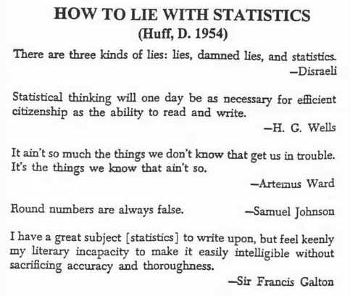

Slide 7
What is "statistics"?
The term "statistics" has two common meanings, which we want to clearly separate: descriptive and inferential statistics.
But to understand the difference between descriptive and inferential statistics, we must first be clear on the difference between populations and samples.
Courtesy Marshall Ma (and prior sources)
7
Notes:
Descriptive Statistics: Procedures used to organize and present data in a convenient and communicable form.
Inferential Statistics: Procedures employed to arrive at broader conclusions or inferences about the populations on the basis of samples.
Courtesy Marshall Ma (and prior sources)

Slide 8
Populations and samples
A population is a set of well-defined objects
We must be able to say, for every object, if it is in the population or not
We must be able, in principle, to find every individual of the population
A geographic example of a population is all pixels in a multi-spectral satellite image
A sample is a subset of a population
We must be able to say, for every object in the population, if it is in the sample or not
Sampling is the process of selecting a sample from a population
Continuing the example, a sample from this population could be a set of pixels from known ground truth points
Courtesy Marshall Ma (and prior sources)
8
Notes:
Population: The complete set of actual or potential elements about which inferences are made.
Sample: A subset of the population selected using some sampling method.
Courtesy Marshall Ma (and prior sources)

Slide 9
Populations and samples Definitions
Population : The complete set of actual or potential elements about which inferences are made
Sample : A subset of the population selected using some sampling methods.
Image Credit/Reference: Quick Study Statistics
9
Notes:
Courtesy Marshall Ma (and prior sources)

Slide 10
Populations and samples
Population : The complete set of actual or potential elements about which inferences are made
Sample : A subset of the population selected using some sampling methods.
Reference: Quick Study Statistics
Image Courtesy: https://www.cliffsnotes.com/study-guides/statistics/sampling/populations-samples-parameters-and-statistics
10
Notes:
Courtesy Marshall Ma (and prior sources)
https://www.cliffsnotes.com/study-guides/statistics/sampling/populations-samples-parameters-and-statistics

Slide 11
Populations and samples
A population = “all” of the data, if you can get it (BIG Data)
This is what is different about the methods you use
A sample = “some” of the data, and you may not know how representative it is
This is what limits analysis but certainly the development of models
Courtesy Marshall Ma (and prior sources)
11
Notes:
Courtesy Marshall Ma (and prior sources)

Slide 12
Sampling Types (basic)
Random Sampling
Sampling in which the data is collected using chance methods or random numbers.
Systematic Sampling
Sampling in which data is obtained by selecting every kth object.
Convenience Sampling
Sampling in which data is readily available is used.
Stratified Sampling
Sampling in which the population is divided into groups (called strata) according to some characteristic. Each of these strata is then sampled using one of the other sampling techniques.
Cluster Sampling
Sampling in which the population is divided into groups (usually geographically). Some of these groups are randomly selected, and then all of the elements in those groups are selected.

Slide 13
Sampling Methods
Simple Random Sampling
Cluster Sampling
Stratified Sampling
13
Notes:
Courtesy Marshall Ma (and prior sources)

Slide 14
Sampling Methods
Simple Random Sampling: A sample selected so that each possible sample of the same size has an equal probability of being selected; used for most elementary inference
Courtesy: Quick Study Academic – Statistics www.quickstudy.com
Reference: Quick Study Statistics
Image Courtesy: https://www.slideshare.net/mohammedzuhairy1/sampling-techniques-64917617
14
Notes:
Courtesy Marshall Ma (and prior sources)

Slide 15
Sampling Methods
Stratified Sampling: The population is divided into strata, and a fixed number of elements of each stratum are selected for the sample.
https://en.wikipedia.org/wiki/Stratified_sampling
15
Notes:
Courtesy Marshall Ma (and prior sources)

Slide 16
Sampling Methods
Cluster Sampling: The population is divided into groups called clusters; some clusters are randomly selected, and every member in them observed.
https://en.wikipedia.org/wiki/Cluster_sampling
16
Notes:
Courtesy Marshall Ma (and prior sources)

Slide 17
Variable
Variable: An attribute of a population or sample that can be measure.
Example: weight, height, eye-color, pulse rate are some of the many variables that can be measured for people.
17
Notes:
Courtesy Marshall Ma (and prior sources)

Slide 18
Data
Data
Types of Data:
Qualitative (or Categorical)
Quantitative (data like numeric values)
18
Notes:
Courtesy Marshall Ma (and prior sources)

Slide 19
Data
Qualitative :
Qualitative (or Categorical) data are descriptive, but not numeric.
Example: your eye-color, you gender, color of a vehicle, your birthplace
19
Notes:
Courtesy Marshall Ma (and prior sources)

Slide 20
Data
Quantitative :
Quantitative (data like numeric values)
- Discreate data take counting numbers (0,1,2,3..) this is used to represent things that can be counted. Example: Number of times an employee is late to work. Number of cars parking lot in the parking garage.
- Continuous data can take a range of numeric values, not just the counting numbers (fractions, decimals are included..) Example: height of a person, weight of an apple, amount of times an employee late to work.
Courtesy: Quick Study Academic – Statistics www.quickstudy.com
20
Notes:
Courtesy Marshall Ma (and prior sources)
Quick Study Academic – Statistics

Slide 21
Levels of Measurement
Qualitative (or Categorical) data can be measured at the:
Nominal Level: Values are just names, without any order (example: eye-color)
Ordinal Level: Values have some natural order, example: high school class (freshman, sophomore, ..) military rank
Quantitative (data like numeric values) can be measured at the:
Interval Level: Numeric data with no natural zero point; intervals (differences) are meaningful but ratios are not, example: Temperature in Fahrenheit degrees 80F is not 20F hotter than 60F, but it is not 150% as hot.
Ratio Level: Numeric data which there is true zero, both intervals and ratios are meaningful; Example: weight, length, duration
Courtesy: Quick Study Academic – Statistics www.quickstudy.com
21
Notes:
Courtesy Marshall Ma (and prior sources)
www.quickstudy.com

Slide 22
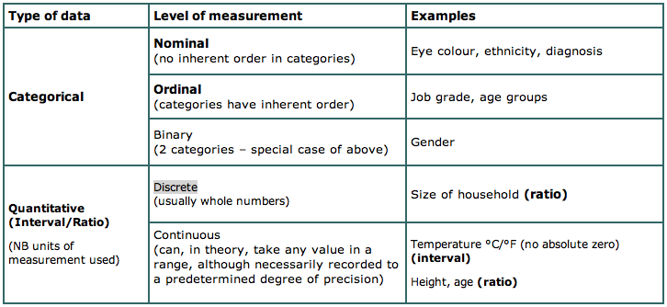
Types of Data

Slide 23
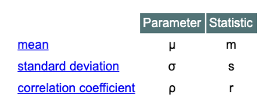
Parameter
Parameter: A numeric measure that describe a population: parameters are usually not computed; but are inferred from sample statistics.
Parameters are normally denoted using Greek symbols, whereas the corresponding statistics are denoted using Latin letters. Below you find a list of the most important parameters and the corresponding statistics.
Courtesy: Quick Study Academic – Statistics www.quickstudy.com
Resources & Image Credit: http://www.statistics4u.info/fundstat_eng/cc_parameter.html

Slide 24
Something to remember…
Difference between “N” and “n”
Population N
Sample n

Slide 25
Special values in data
Fill value
Error value
Missing value
Not-a-number (NAN)
Infinity
Default
Null
Rational numbers
Notes:
Infinity – because they are calculated, can get divided by a zero

Slide 26
Outlier
An extreme, or atypical, data value(s) in a sample.
They should be considered carefully, before exclusion from analysis.
For example, data values maybe recorded erroneously, and hence they may be corrected.
However, in other cases they may just be surprisingly different, but not necessarily 'wrong'.

Slide 27
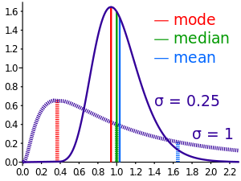
Central tendency – median, mean, mode
Notes:
http://upload.wikimedia.org/wikipedia/commons/thumb/d/de/Comparison_mean_median_mode.svg/300px-Comparison_mean_median_mode.svg.png

Slide 28
Measure of Central Tendency
Mean: Most commonly used measure of central tendency, commonly meant by “Average”, sensitive to extreme values (sensitive to outliers)
Population Mean
Sample Mean
https://www.youtube.com/watch?v=k5EbijWu-Ss
Image Resource: https://www.onlinemathlearning.com/population-mean.html
Courtesy: Quick Study Academic – Statistics www.quickstudy.com

Slide 29
Measure of Central Tendency
Median: Value that divides the set in so the same number of observations lie on each side of it;
Median is less sensitive to extreme values
For an even number, it is the average of middle two values
Courtesy: Quick Study Academic – Statistics www.quickstudy.com
Image Resource: https://en.wikipedia.org/wiki/Median

Slide 30
Measure of Central Tendency
Mode: Observation that occurs with the greatest frequency.
Courtesy: Quick Study Academic – Statistics www.quickstudy.com
Image Resource: https://www.mathsisfun.com/definitions/mode.html
Notes:
https://www.mathsisfun.com/definitions/mode.html

Slide 31

Mean;Median;Outlier
Found this on Twitter… Credit: Anna .J. Egalite

Slide 32
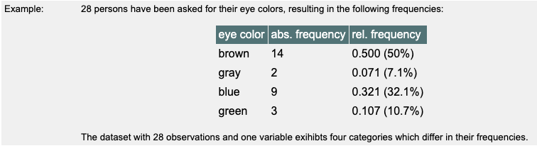
Frequencies…
The Absolute frequency n_{i} is the number of observations belonging to a category a_{i} or falling into a particular class c_{i}. The sum of all frequencies of all categories/classes is equal to N, the total number of observations:
Σn_{i} = N
Relative frequencies f_{i} are obtained by normalizing the individual frequencies to a total sum of 1.0 (or 100%, respectively). This way the frequencies become independent of the sample size and will be comparable to each other.
Frequencies are usually delineated in a frequency table or displayed as a histogram.
Resource & Image Credit: http://www.statistics4u.info/fundstat_eng/ee_frequency.html

Slide 33
Ranges: z, Percentiles, Quartiles
The standard score is obtained by subtracting the mean and dividing the difference by the standard deviation. The symbol is z, which is why it's also called a z-score.
Percentiles (quantiles) (100 regions)
The kth percentile is the number which has k% of the values below it. The data must be ranked.
Quartiles (4 regions)
The quartiles divide the data into 4 equal regions.
Note: The 2nd quartile is the same as the median. The 1st quartile is the 25th percentile, the 3rd quartile is the 75th percentile.

Slide 34
Getting Started : Rstudio – MASS library
install.packages("MASS") # installing the MASS package
library(MASS) # load the library MASS
attach(Boston) # attaching the dataset
?Boston # help function with "?"
head(Boston) # show the head of the dataset
dim(Boston) # dimensions of the dataset
names(Boston) # column names
str(Boston) # str function shows the structure of the dataset
nrow(Boston) # function shows the number of rows
ncol(Boston) # function shows the number of columns
summary(Boston) # summary() function shows the summary statistics
summary(Boston$crim) # summary of the "crime" column in the Boston dataset

Slide 35
Getting Started : Rstudio – ISLR library – Auto dataset
install.packages("ISLR") # installing the ISLR package
library(ISLR)
data(Auto)
head(Auto)
names(Auto)
summary(Auto)
summary(Auto$mpg)
fivenum(Auto$mpg)
boxplot(Auto$mpg)
hist(Auto$mpg)
summary(Auto$horsepower)
summary(Auto$weight)
fivenum(Auto$weight)
boxplot(Auto$weight)
mean(Auto$weight)
median((Auto$weight))

Slide 36
Time to “Play ☺” with the data
In class work – Explore the EPI dataset –
http://aquarius.tw.rpi.edu/html/DA/
And some directories under this link
– please search before ask !!!
This is where the files for assignments, lab exercises are
data and code fragments…

Slide 37
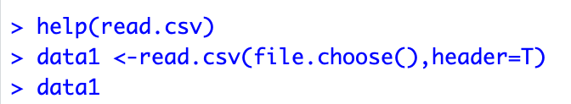

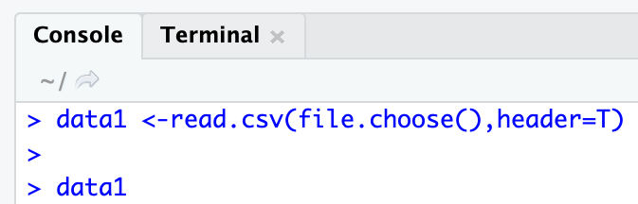
Read a CSV file in R
Begin with reading a CSV file..
Choose the CSV file

Slide 38
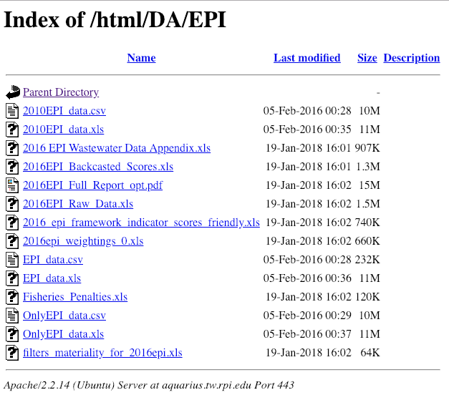
EPI data set
https://aquarius.tw.rpi.edu/html/DA/EPI/

Slide 39
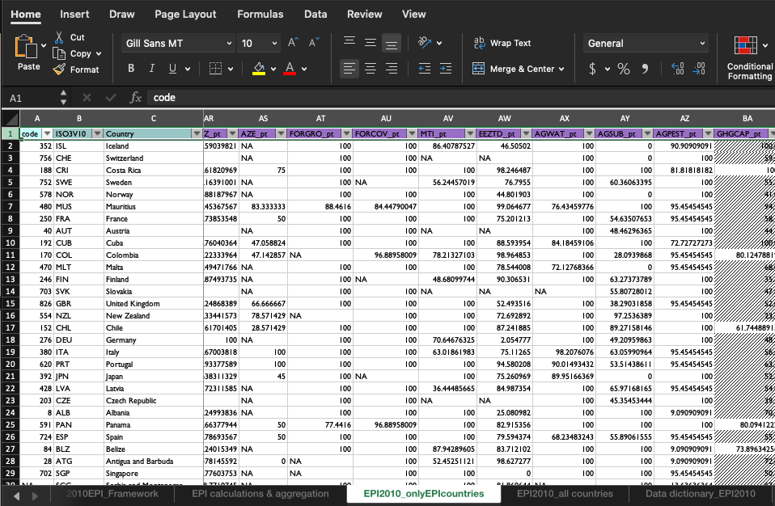
2010EPI_data.xls

Slide 40
Data Prepared for Analysis = Munging
Missing values, null values, etc.
E.g. in the EPI_data – they use “--”
Most data applications provide built ins for these higher-order functions – in R “NA” is used and functions such as is.na(var), etc. provide powerful filtering options (we’ll cover these on next Friday)
Of course, different variables often are missing “different” values
In R – higher-order functions such as: Reduce, Filter, Map, Find, Position and Negate will become your enemies and then your friends: http://www.johnmyleswhite.com/notebook/2010/09/23/higher-order-functions-in-r/
Notes:
Plot the EPI data set
R is smart – R will not plot things can not be plotted. It will throw you an error.
NOTE: in EPI data set, when the values are missing it will show “ – --” two dashes .
NA = Not Available

Slide 41
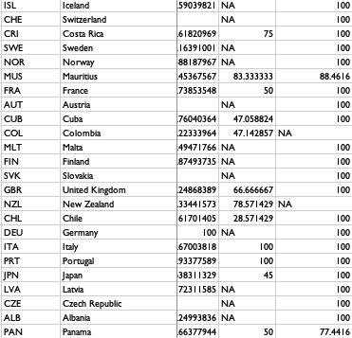
Explore the “Missing values” -- NA

Slide 42
Five-number summary
The five-number summary is a set of descriptive statistics that provide information about a dataset. It consists of the five most important sample percentiles:
the sample minimum (smallest observation)
the lower quartile or first quartile
the median (the middle value)
the upper quartile or third quartile
the sample maximum (largest observation)
Read: https://en.wikipedia.org/wiki/Five-number_summary

Slide 43
Getting started – look at the data
Visually
What is the improvement in the understanding of the data as compared to the situation without visualization?
Which visualization techniques are suitable for one's data?
Scatter plot diagrams
Box plots (min, 1st quartile, median, 3rd quartile, max)
Stem and leaf plots
Frequency plots
Group Frequency Distributions plot
Cumulative Frequency plots
Distribution plots
Notes:
Do you improve your understanding about the data by using a visualization ? Better insights with visualizations ?
Example : Stock market data make more sense when you see the graph/plots rather than looking at the plain data on excel sheet

Slide 44
Why visualization?
Reducing amount of data
Patterns
Features
Events
Trends
Irregularities
Leading to presentation of data, i.e. information products
Notes:
Aims of having a visualization is to point out the “Patterns”, “Features”, “Trends”

Slide 45
Exploring the distribution
> summary(EPI) # stats
Min. 1st Qu. Median Mean 3rd Qu. Max. NA's
32.10 48.60 59.20 58.37 67.60 93.50 68
> boxplot(EPI)
> fivenum(EPI,na.rm=TRUE)
[1] 32.1 48.6 59.2 67.6 93.5
Tukey: min, lower hinge, median, upper hinge, max
Notes:
https://en.wikipedia.org/wiki/Five-number_summary

Slide 46
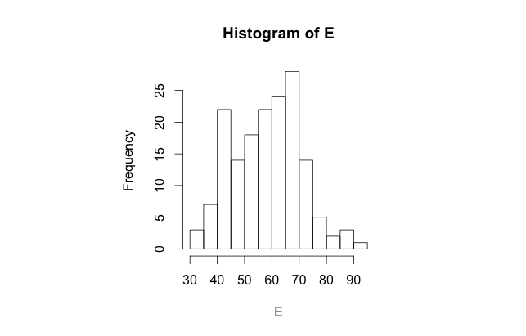
Grouped Frequency Distribution aka binning
> hist(EPI) #defaults
Notes:
Histogram with bins

Slide 47
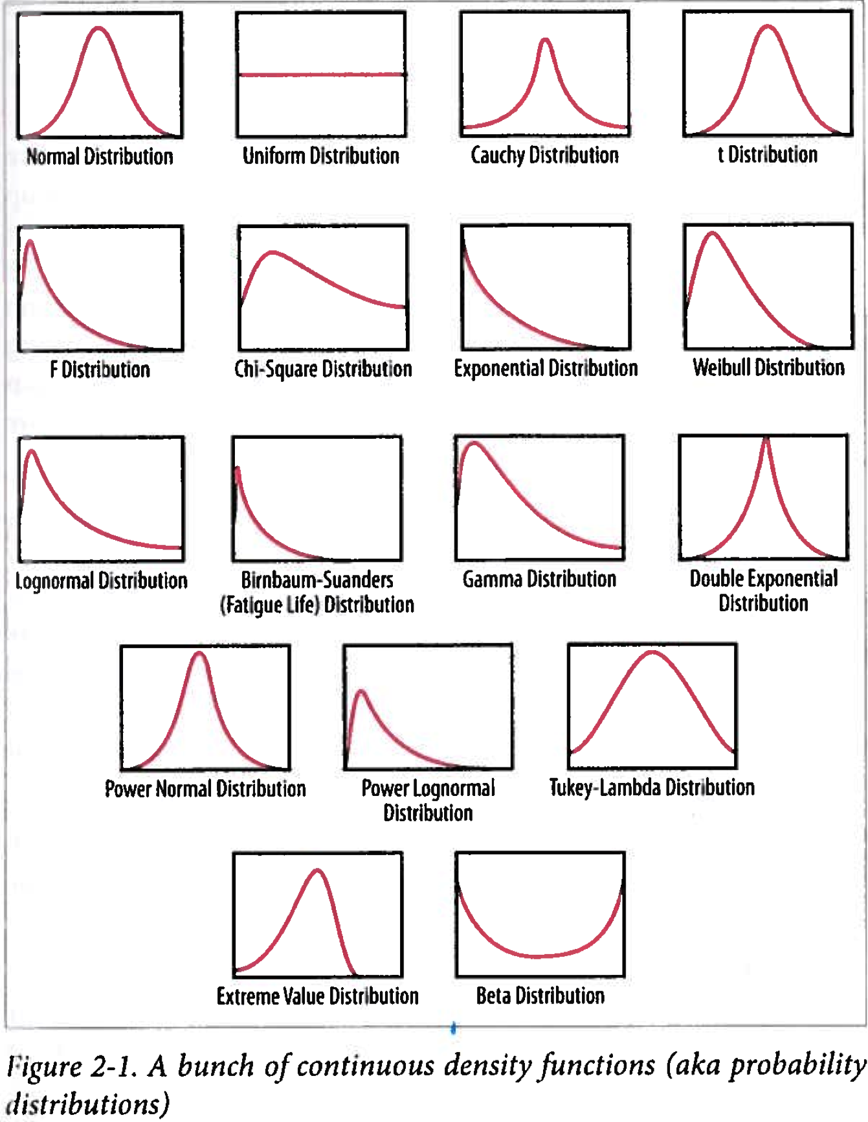
Distributions
Shape
Character
Parameter(s)
Which one fits?
Notes:
Another look at the distributions
First thing we do is we look at something partially look like our histogram
What distribution corresponds to the histogram

Slide 48
Distributions
http://www.quantitativeskills.com/sisa/rojo/alldist.zip
Shape
Character
Parameter(s)
Mean
Standard deviation
Skewness
Etc.

Slide 49
Plotting these distributions
Histograms and binning
Getting used to log scales
Going beyond 2-D
More of this in lab 1 and module 3

Slide 50
In applications
Scipy: http://docs.scipy.org/doc/scipy/reference/stats.html
R: http://stat.ethz.ch/R-manual/R-patched/library/stats/html/Distributions.html
Matlab: http://www.mathworks.com/help/stats/_brn2irf.html
Excel: see http://aquarius.tw.rpi.edu/html/DA/distribution

Slide 51
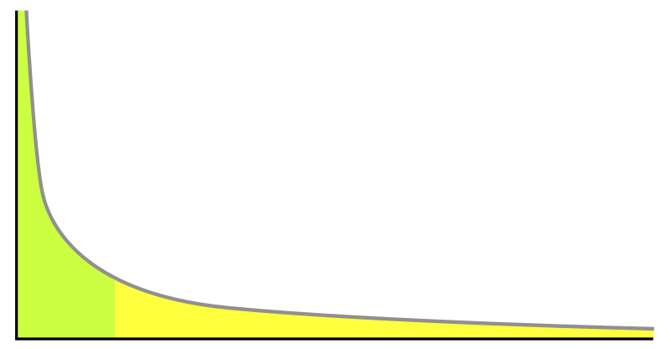
Heavy-tail distributions
are probability distributions whose tails are not exponentially bounded
Common – long-tail… human v. cyber…
Few that dominate
More that add up
Equal areas
http://en.wikipedia.org/wiki/Heavy-tailed_distribution
Notes:
http://upload.wikimedia.org/wikipedia/commons/8/8a/Long_tail.svg

Slide 52
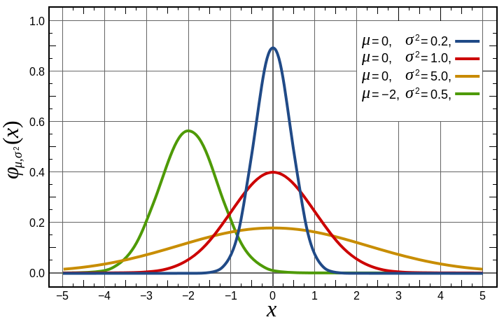
Probability Density

Slide 53
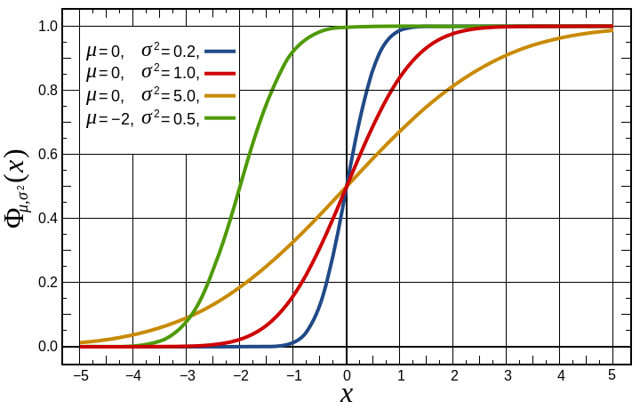
Cumulative…

Slide 54
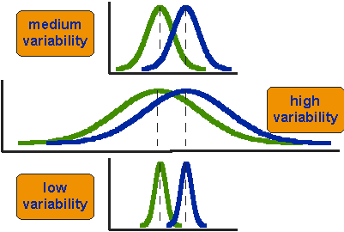
Variability in normal distributions
Notes:
http://www.socialresearchmethods.net/kb/Assets/images/stat_t2.gif

Slide 55
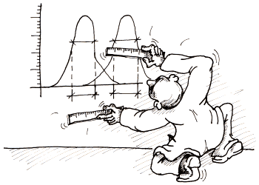
F-test
F = S₁² / S₂²
where S₁ and S₂ are the sample variances.
The more this ratio deviates from 1, the stronger the evidence for unequal population variances.
Notes:
http://www.statistics4u.info/fundstat_eng/img/gm_compvaria_tusche.png
http://www.statistics4u.info/fundstat_eng/

Slide 56
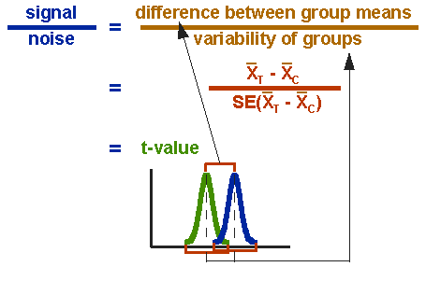

T-test
Notes:
http://www.socialresearchmethods.net/kb/Assets/images/stat_t3.gif

Slide 57
Note on Standard Error
Versus standard deviation = SD (i.e. from the mean)
SE ~ SD/sample size
So, as size increases SE << SD !! Big data

Slide 58
Frequencies v. Probabilities
Actual rate of occurrence in a sample or population – frequency
Expected or estimate likelihood of a value or outcome – probability
Coin toss – two outcomes (binomial)
p= 0.5 (of “heads”)
Male/Female
Which US State you live in
Notes:
The Absolute frequency n_{i} is the number of observations belonging to a category a_{i} or falling into a particular class c_{i}. The sum of all frequencies of all categories/classes is equal to N, the total number of observations:
Σn_{i} = N
Relative freqencies f_{i} are obtained by normalizing the individual frequencies to a total sum of 1.0 (or 100%, respectively). This way the frequencies become independent of the sample size and will be comparable to each other. Frequencies are usually delineated in a frequency table or displayed as a histogram. The frequency table contains the absolute and the relative frequencies n_{i} and f_{i} for all categories a_{i}:
See: http://www.statistics4u.info/fundstat_eng/ee_frequency.html

Slide 59
Hypothesis
Write the original claim and identify whether it is the null hypothesis or the alternative hypothesis.
Write the null and alternative hypothesis. Use the alternative hypothesis to identify the type of test.
Write down all information from the problem.
Find the critical value using the tables
Compute the test statistic
Make a decision to reject or fail to reject the null hypothesis. A picture showing the critical value and test statistic may be useful.
Write the conclusion.

Slide 60
Hypothesis
What are you exploring?
Regular data analytics features ~ well defined hypotheses
Big Data messes that up - discuss
E.g. Stock market performance / trends versus unusual events (crash/ boom):
Populations versus samples – which is which?
Why?
E.g. Election results are predictable from exit polls

Slide 61
Null and Alternate Hypotheses
H0 - null
H1 – alternate
If a given claim contains equality, or a statement of no change from the given or accepted condition, then it is the null hypothesis, otherwise, if it represents change, it is the alternative hypothesis.
It never snows in Troy in January
Students will attend their scheduled classes

Slide 62
P-value
One common way to evaluate significance, especially in R output
approaches hypothesis testing from a different manner. Instead of comparing z-scores or t-scores as in the classical approach, you're comparing probabilities, or areas.
The level of significance (alpha) is the area in the critical region. That is, the area in the tails to the right or left of the critical values.

Slide 63
P-value
The p-value is the area to the right or left of the test statistic.
If it is a two tail test, then look up the probability in one tail and double it.
If the test statistic is in the critical region, then the p-value will be less than the level of significance.
It does not matter whether it is a left tail, right tail, or two tail test. This rule always holds.

Slide 64
Accept or Reject?
Reject the null hypothesis if the p-value is less than the level of significance.
You will fail to reject the null hypothesis if the p-value is greater than or equal to the level of significance. In English – you accept that there is no relation!
Typical significance 0.05 (!)

Slide 65
E.g. Election prediction
Exit polls versus election results
Human versus cyber
How is the “population” defined here?
What is the sample, how is it chosen?
What is described and how is that used to predict?
Are results categorized? (where from, M/F, age)
What is the uncertainty?
It is reflected in the “sample distribution”
And controlled/ constraints by “sampling theory”

Slide 66
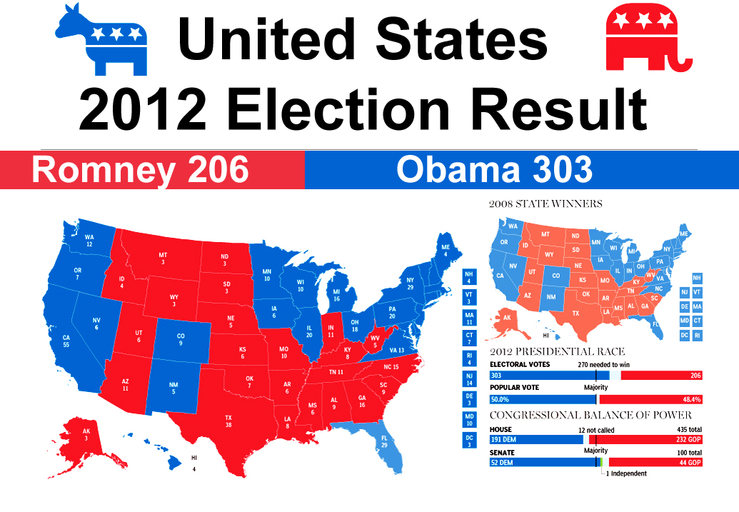
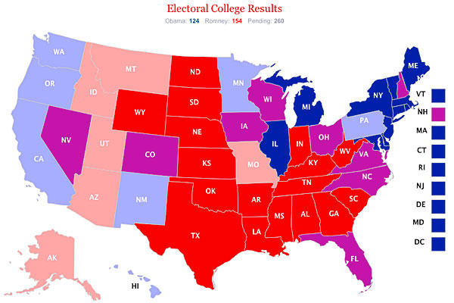
Bias difference: between cyber and human data
2012 (!not 2016) election results and exit polls
What are examples of bias in election results?
In exit polls?
Notes:
http://www.mapsnworld.com/blog/wp-content/uploads/2012/11/election-results-map-usa-2012.jpg
http://www.csmonitor.com/var/ezflow_site/storage/images/media/content/2012/11-6-12-7-35-pm-results/14234173-7-eng-US/11-6-12-7-35-pm-results_full_600.jpg

Slide 67
Random Numbers
Can a computer generate a random number?
Can you?
Origin – to reduce selection bias!
In R – many ways – see help on Random {base} and get familiar with set.seed()
We will talk about this more later…

